Slide 1
Twitter Sentiment Extraction
1

Slide 2
Contents...
Introduction
Dataset
EDA
Modeling
Conclusion
2

Slide 3
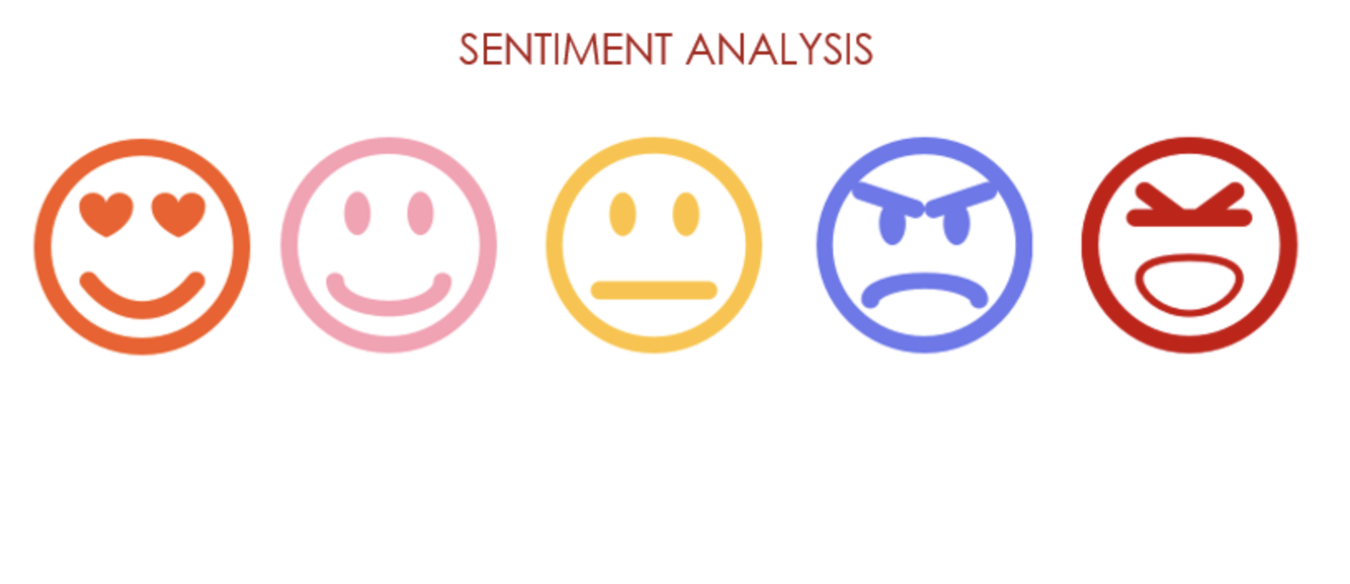
Introduction
Twitter is a social networking service on which users post and interact with messages known as “tweets”
In my project I will analyze people tweets to get their sentiments out of their tweets.
3

Slide 4
Dataset
The Dataset used was token from “www.Kaggle.com”
The data has more than 27000 rows and 4 columns
4

Slide 5
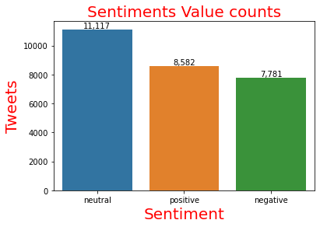
EDA
As we can see here
More than 11,000 tweets is neutral.
More than 8,500 tweets is positive.
More than 7,500 tweets is negative.
5

Slide 6
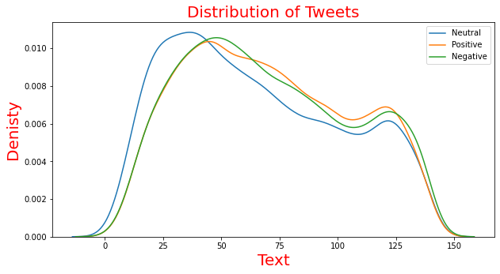
EDA
As we can see here the distribution of tweets is most likely in the range of 25-80 Characters
6

Slide 7
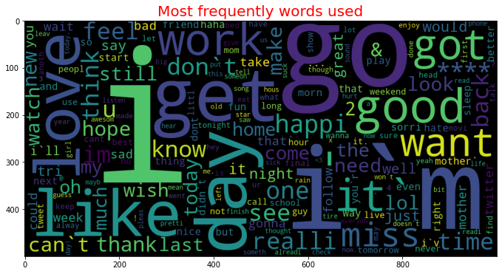
7
In this figure we can see most frequently words used in tweets

Slide 8
Modeling
Using “Non-Negative Matrix Factorization (NMF)” Mode I get 10 topics of people tweets and what are they talking about.
9

Slide 9
NMF
Topic | words | expression
1 | get, home, back, hope, cant, readi, didnt, better, time, need | Going home
2 | day, mother, happi, mom, there, mum, mommi, wish, war, star | Mothers love
3 | go, want, home, bed, see, tonight, back, wish, wanna, sleep | need to sleep
4 | work, today, tomorrow, time, back, weekend, still, hour, day, doesnt | Working
5 | thank, you, follow, much, that, lol, great, me, ill, well | gratitude
6 | im, sorri, sad, tire, gonna, cant, bore, still, sick, glad | Being sorry
7 | good, morn, night, hope, luck, morning, day, time, feel, today | Day luck
8 | it, rain, time, yeah, great, think, friday, cant, today, day | about weather
9 | dont, like, know, feel, think, want, lol, realli, make, look | Express feelings
10 | love, miss, you, much, see, mom, new, would, come, one | Missing mums
10

Slide 10
SVM Modeling
Train confusion matrix
5083 | 284 | 58
98 | 7509 | 167
83 | 274 | 5680
Test confusion matrix
1187 | 1051 | 118
310 | 2723 | 310
62 | 825 | 1658
11
Train accuracy score : 94.9%
Test accuracy score : 67.5%

Slide 11

Conclusion
I used the data to classify the tweets based on the sentiments of the word used.
I found that most tweets are neutral and positive
12

Slide 12
Thank you
13

